Slide 1
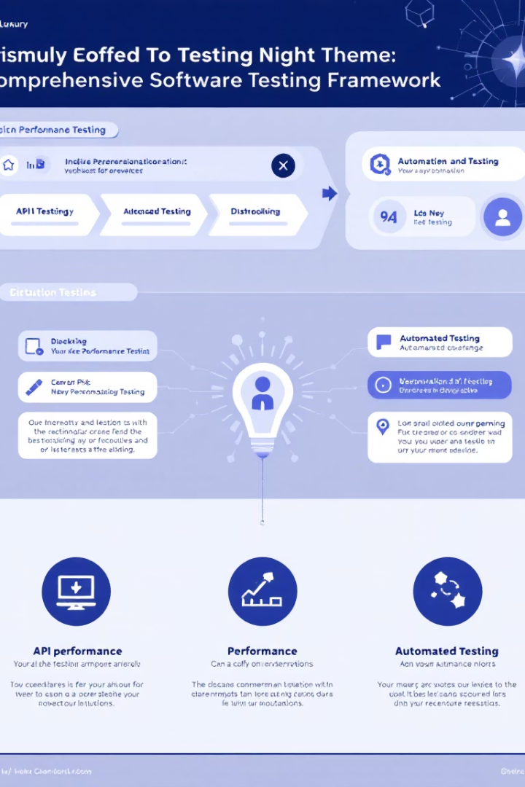
Parabank
Automated Testing Framework
A Comprehensive Quality Assurance Approach for a Simulated Online Banking System

Slide 2

✅ Presented by
Abdelrahman Abodief Mohamed
Areej Abdulkader Abdulkader Gouda
Alaa Shalaby AbdAllah
Doaa Azazy Salem
Marwan Mahmoud Hashem

Slide 3

🌟 Welcome
Welcome to our project on Automated Testing for ParaBank, a demo online banking application designed for testing practice. In this project, we designed and implemented a robust testing framework that covers UI testing, API testing, performance testing, and end-to-end validation using modern tools and methodologies.
Our goal was to simulate real-world testing scenarios and challenges, ensuring high reliability, usability, and performance of the application under different conditions. This project reflects our understanding of QA practices and demonstrates our ability to work collaboratively on a complete test lifecycle—from planning and execution to reporting and analysis.

Slide 4
📝 Agenda
Project Overview
About ParaBank
Project Objectives
Website Structure & Key Features
Testing Approaches
Testing scope
API Testing with Postman
Performance Testing with Jmeter (load/stress)
Automated UI Testing with Selenium
CI/CD reporting with jenkins
End-to-End Testing Strategy
Documentation (GitHub/Jira)
Test Results
API Testing report
Load testing report
Stress Testing report
Automated UI Testing report
CI/CD report
Key findings & Recommendation
Recommendation due to testing results
Q&A

Slide 5

💻 Introduction to ParaBank
A Testing-Friendly Online Banking Demo
ParaBank is a demo web application developed by Parasoft, designed specifically for practicing and testing automation in a simulated online banking environment. It mimics a real-world banking system, making it an ideal target for functional, UI, API, and end-to-end testing.
🧱 Website Structure Overview
Key Services Provided by ParaBank
ParaBank offers a realistic banking interface with key sections including a login and registration page, a user dashboard showing account summaries, and services for viewing transactions, opening accounts, and transferring funds. It also provides online features like updating user info, loan requests, and access to a RESTful API for backend testing.

Slide 6
✅ Best Approaches to Testing ParaBank
🧪 UI Testing
ParaBank’s UI can be tested using Selenium, Playwright, or Cypress, covering flows like login, account creation, and fund transfers. Using the Page Object Model (POM) improves test maintainability.
🔌 API Testing
API testing can be done using Postman, RestAssured, or Python Requests, focusing on status codes, response accuracy, and authentication. It's especially useful for edge cases and negative testing.
🔁 End-to-End Testing
Combining API and UI tests—for example, creating a transaction via API and verifying it through the UI—helps ensure end-to-end coverage and validates overall business flow integrity.
🔄 Performance Testing
Tools like JMeter, Gatling, or Locust are recommended for performing stress and load testing to evaluate ParaBank’s performance under heavy usage.

Slide 7




Testing Scope
API Testing
Performance Testing
Ensuring API correctness, reliability, and security with Postman.
Evaluating system performance under various user loads with JMeter.
Automated Testing
CI / CD Reporting
Implementing scripts for key workflows using Selenium.
Generate detailed test reports on a scheduled basis.
GitHub Repo
Jira Issues
Managing project-related tasks and bugs.
To track Bugs and Issues

Slide 8
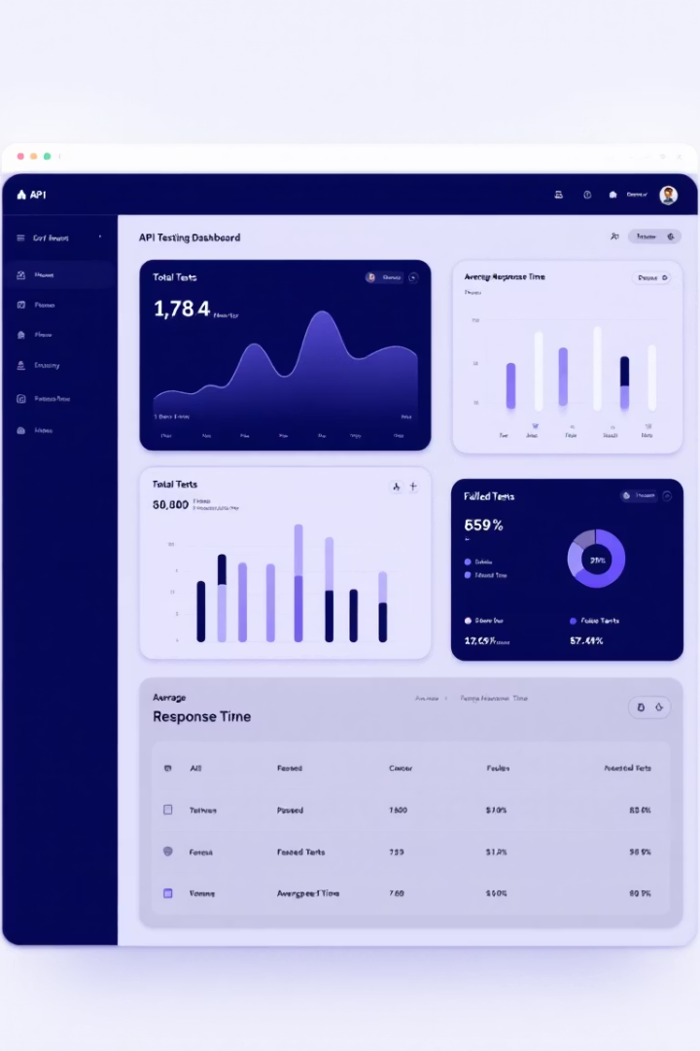
API Testing Results
154
Total Tests
Comprehensive API test coverage
145
Passed Tests
High success rate of 94.2%
9
Failed Tests
Issues in transaction and loan operations
293ms
Avg Response
Fast execution across all endpoints

Slide 9

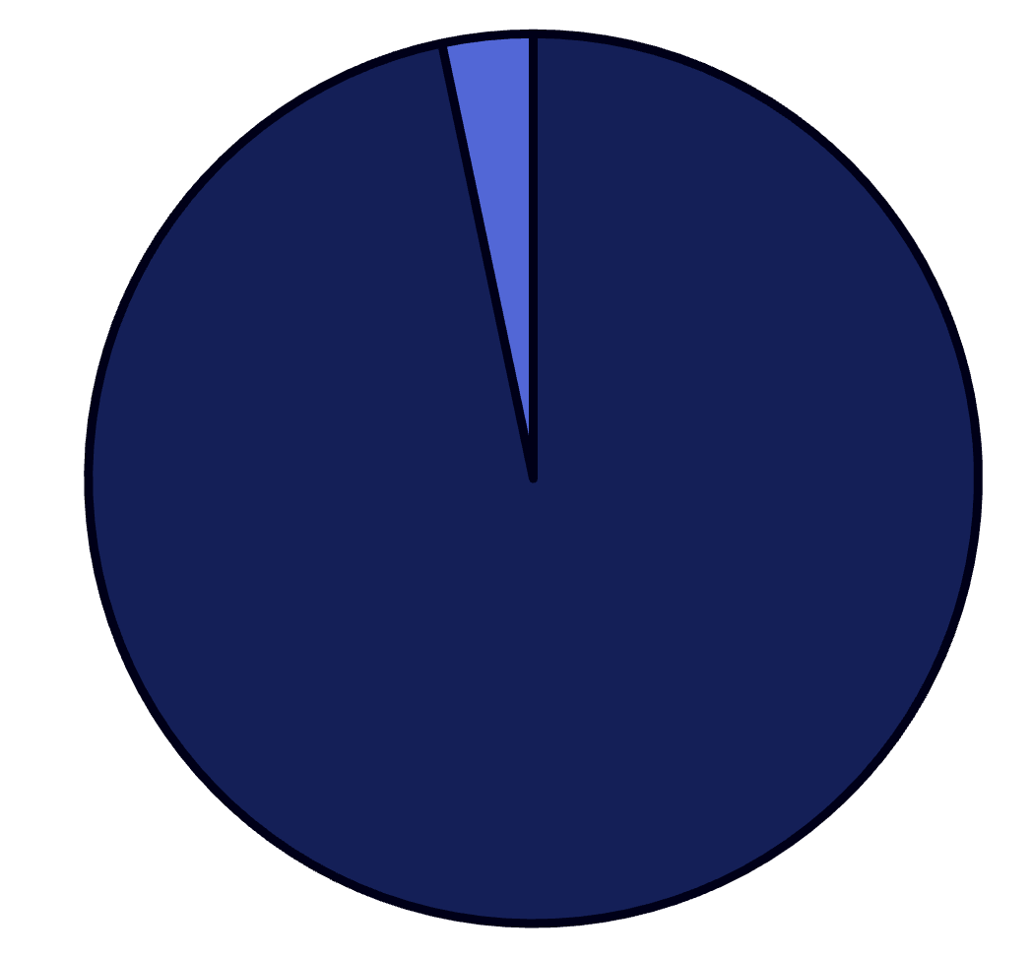




Load Testing Scenario
User Simulation
1,000 virtual users with gradual ramp-up over 300 seconds
Request Timing
Randomized delay of 1-1.5 seconds between requests
Transaction Flow
Complete banking workflow from login to logout
Performance Metrics
Successful
Failed
The system handled 1,000 concurrent users with a 96.7% success rate.
Only 45 users failed to create accounts,
while 814 users completed all transactions successfully.
Response times, success rates, and user completion tracking

Slide 10



Stress Testing Approach
Start with 1,000 users
Initial baseline for system performance
Add 500 users every 60 seconds
Gradual increase to find breaking points
Reach 5,000 total users
Maximum load to test system limits

Slide 11

Stress Testing Results
Overall Success Rate: 82.23%
Response Time Impact
Critical Failure Points
Average: 2,661.89 ms
Account creation: ~55% success
System showed moderate resilience under high stress but experienced degradation as user count increased.
Maximum: 33,100 ms
Registration: 64% success
90th Percentile: 6,311 ms
Transactions: ~73% success

Slide 12








Functional Testing Approach
User Management
Account Operations
Registration, login, profile updates
Creating accounts, checking balances
Financial Services
Transactions
Loan requests and approvals
Transfers, bill payments, searches

Slide 13
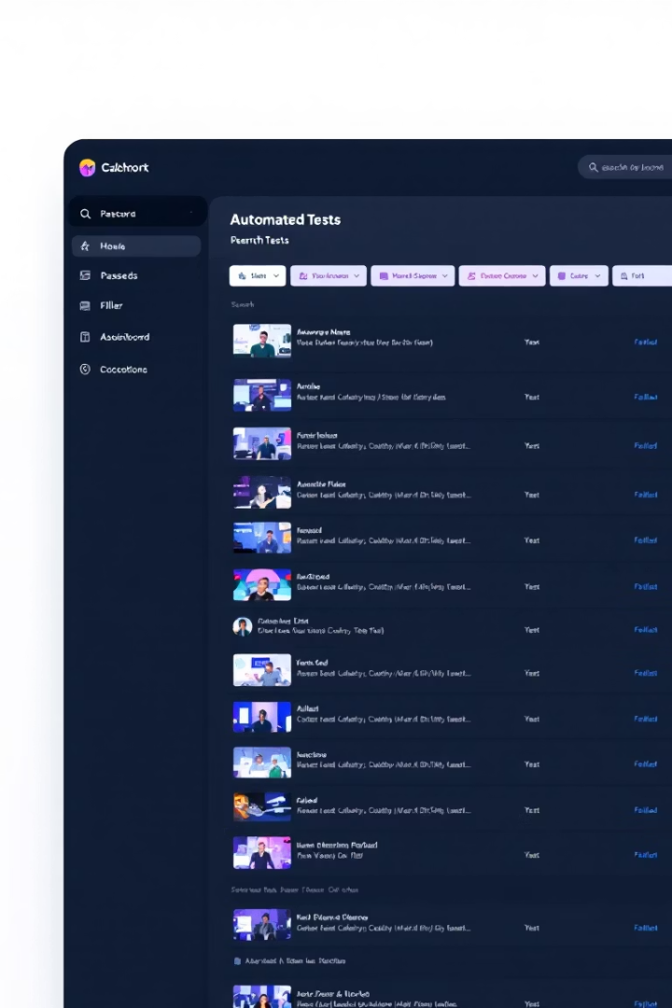
Functional Testing Results
78
Test Cases
Comprehensive functional coverage
77
Passed
High success rate of 98.7%
1
Failed
Transaction search by ID issue
3:59
Minutes
Total execution time

Slide 14
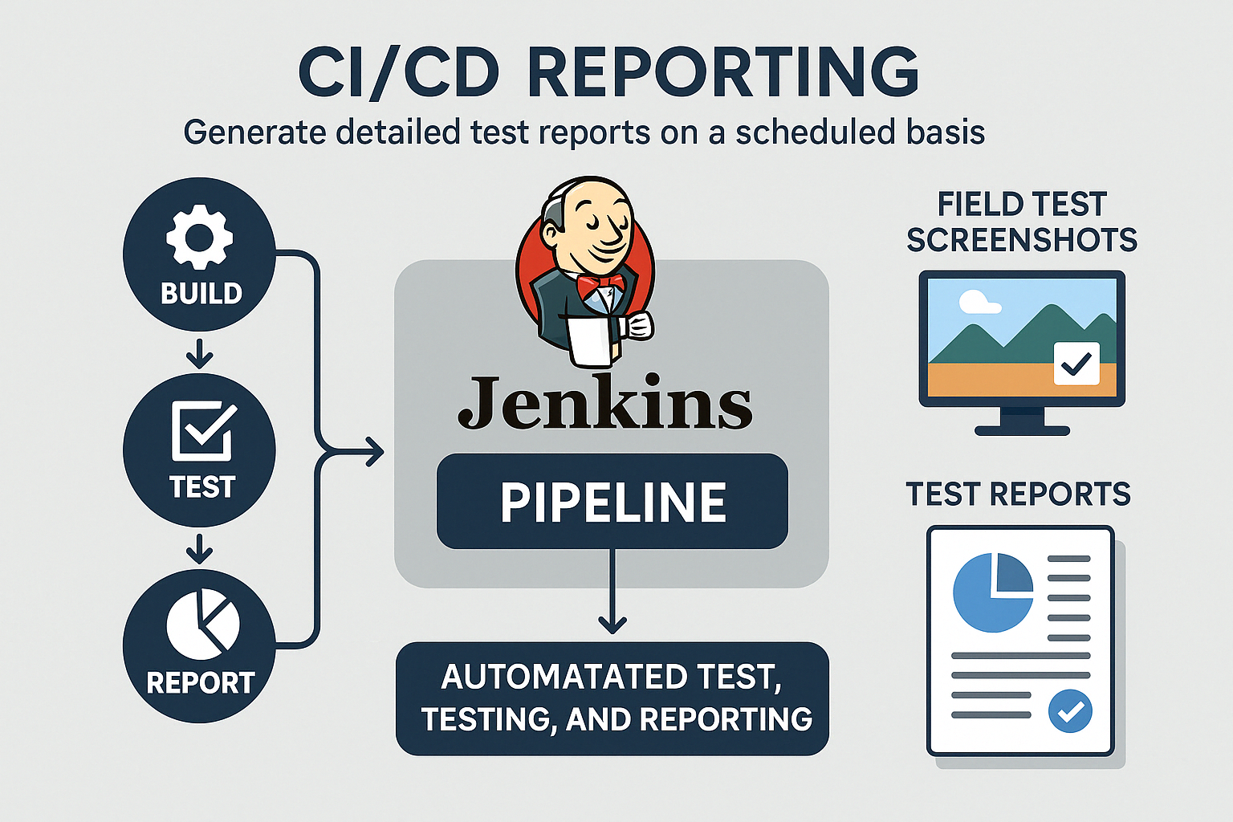

Slide 15
Key Findings & Recommendations
API Testing
Performance Testing
Functional Testing
Investigate 9 failed tests in transaction and loan operations. Review API response formats to ensure correct data structures.
Address account creation failures. Optimize critical transactions with high response times. Scale resources during peak loads.
Fix transaction search by ID functionality. Implement more robust error handling for internal server errors.

Slide 16
Thank You

